Slide 1
Smart Notice Board with ESP8266 & Dot Matrix LED Display
-By
E.BARATH
CHANDRA SHEKAR
CHETAN HARSHA
GNAESWAR

Slide 2
COMPONENTS
NodeMCU ESP8266 Board
8-in-1 MAX7219 Dot Matrix LED Display
Jumper Wires
Breadboard
Micro-USB Data Cable

Slide 3
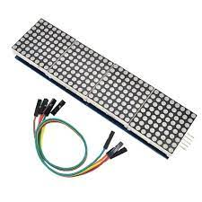
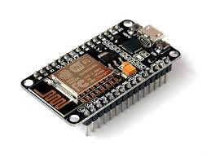
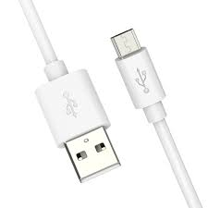
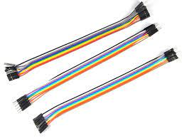
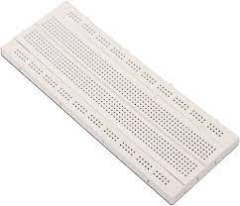
ESP8266 NodeMCU board
8-in-1 MAX7219 Dot Matrix LED Display
Micro-USB Data Cable
Jumper Wires
Breadboard

Slide 4
LITERATURE SURVEY-1
INTRODUCTION:-
Overview of the Project: Provide a brief introduction to your project, explaining the concept of a "Smart Notice Board" using ESP8266 and a Dot Matrix LED Display.
ESP8266 in IoTESP8266 Microcontroller: Review literature that discusses the ESP8266 microcontroller's capabilities, applications in IoT, and wireless communication capabilities.
IoT Applications: Explore papers and articles that highlight various IoT applications and use cases where the ESP8266 plays a central role.

Slide 5
LITERATURE SURVEY-2
Dot Matrix LED Displays
LED Matrix Displays: Review literature related to LED matrix displays, including their types (e.g., MAX7219), operation, and applications in information display and visual communication.
Control and Programming: Look for resources that explain how to control and program LED matrix displays, including libraries and techniques for creating dynamic content.
Human-Computer Interaction (HCI) and User Interface Design
HCI for Digital Signage: Investigate HCI principles and user interface design considerations for digital signage and interactive displays, which are relevant to creating an effective Smart Notice Board.
Content Management: Explore papers discussing content management systems and strategies for updating and maintaining digital notice boards.

Slide 6
LITERATURE SURVEY-3
Wi-Fi and IoT: Review research on Wi-Fi communication in IoT applications, including the role of the ESP8266 in establishing wireless connections.
Wireless Protocols: Explore literature on wireless communication protocols commonly used in IoT, such as MQTT or HTTP.
Environmental Monitoring
Environmental Sensing in IoT: If your project includes environmental monitoring, examine literature on the integration of sensors in IoT projects and the collection of environmental data.
Case Studies and Project Examples
Similar Projects: Look for case studies, projects, or research papers that describe similar projects involving Smart Notice Boards, LED displays, and IoT technologies. Analyze their methodologies and findings.

Slide 7
LITERATURE SURVEY-4
Challenges and Future Directions
Challenges: Summarize any challenges or limitations mentioned in the literature regarding the use of ESP8266, LED displays, or IoT for notice board applications.
Future Directions: Explore suggestions or areas of improvement mentioned in the literature for future Smart Notice Board projects.
Conclusion
Summary of Findings: Summarize the key findings and insights from the literature survey.
Relevance to Your Project: Discuss how the reviewed literature informs and relates to your specific project on the Smart Notice Board with ESP8266 and Dot Matrix LED Display.
Research Gap: Highlight any gaps in the existing literature that your project aims to address or contribute to.

Slide 8
REASEARCH PAPERS
Digital Notice Board using ESP8266 Wi-Fi Module
-BY M. V. Sujay, T. H. Faisal Sharief , Kiran Naikodi , V. Prajwal ,
→In the present age the sheets are being overused physically. This procedure is hard to include so as putting a notification on the notice board.
→In this an approved client sends the picture of notice by means of PC utilizing a customer based server over the Wi-Fi organize towards the ESP8266 Wi-Fi module.
→ESP8266 Wi-Fi module gets the notice and stores it in its memory and afterward show the pictures as per the program. The notice can be adjusted and modified by customer needs
SMART DISPLAY USING NodeMCU
-BY BALU GIRI BABU
→This paper we have a tendency to square measure attending to create a wise show mistreatment nodeMCU. the most objective of this sensible bulletin board mistreatment NodeMCU is to present a quick change of data while not having a lot of physical work.
→By mistreatment this module we can we will we square measure able to update the data from the place wherever we have a tendency to are with the assistance of web. we are able to send a message to the NodeMCU that internally have a wi-fi module that helps it to receive the message from through the scientific discipline address of the network that it's connected.

Slide 9
CODE
void getData(char *szMesg) { // ... Your existing code for extracting data}
void handleWiFi() { // ... Your existing code for handling WiFi requests}
void setup()
{ Serial.begin(57600); P.begin();
P.setIntensity(0);
P.displayClear();
P.displaySuspend(false);
P.displayScroll(curMessage, PA_LEFT, scrollEffect, frameDelay);
curMessage[0] = newMessage[0] = '\0’;
WiFi.begin(ssid, password);
while (WiFi.status() !=
WL_CONNECTED) { delay(500); }
server.begin();
sprintf(curMessage, "%03d:%03d:%03d:%03d", WiFi.localIP()[0], WiFi.localIP()[1], WiFi.localIP()[2], WiFi.localIP()[3]);}
void loop()
{ handleWiFi();
if (P.displayAnimate())
{ if (newMessageAvailable) { strcpy(curMessage, newMessage);
newMessageAvailable = false; }
P.displayReset();
}
}
#include <ESP8266WiFi.h>
#include <MD_Parola.h>
#include <MD_MAX72xx.h>
#include <SPI.h>
#define DEBUG 0
#if DEBUG
#define PRINT(s, x) { Serial.print(F(s));
Serial.print(x); }
#else
#define PRINT(s, x)
#endifMD_Parola P = MD_Parola(MD_MAX72XX::FC16_HW, 15, 8);
const char* ssid = "***********";
const char* password = "***********";
WiFiServer server(80);
uint8_t frameDelay = 25;
textEffect_t scrollEffect = PA_SCROLL_LEFT;
char curMessage[512],
newMessage[512];
bool newMessageAvailable = false;
const char WebResponse[] = "HTTP/1.1 200 OK\nContent-Type: text/html\n\n";
const char WebPage[] = "..."; // Your HTML here
uint8_t htoi(char c) { c = toupper(c); return (c >= '0' && c <= '9') ? (c - '0') : (c - 'A' + 0xa);}void getData(char *szMesg) { // ... Your existing code for extracting data}

Slide 10
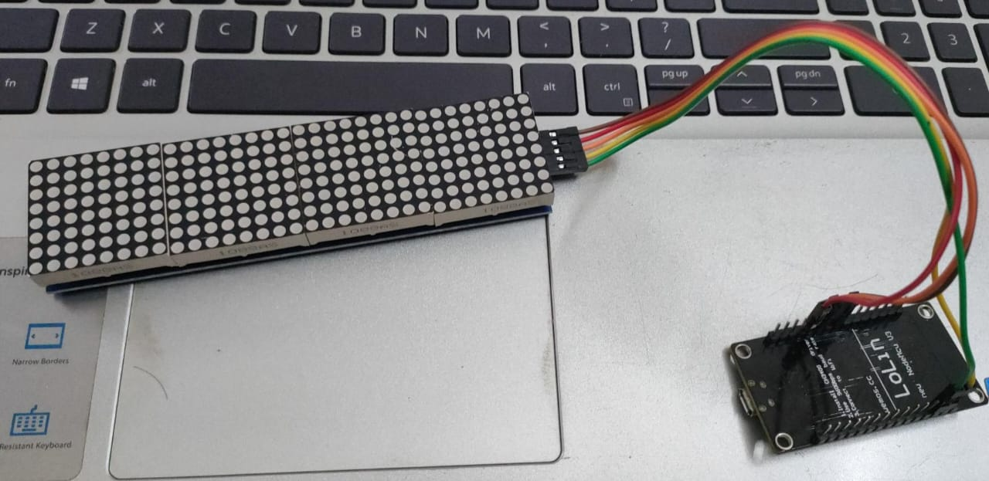
Smart Notice Board with ESP8266 & Dot Matrix LED Display
.

Slide 11
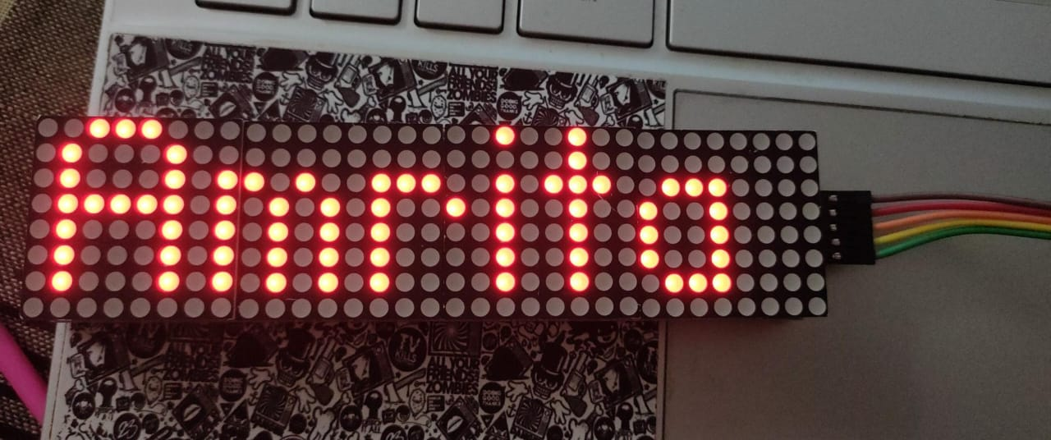
Testing the ESP8266 Smart Notice Board
.

Slide 12
THANK YOU

